Slide 1
Crisis Management and Recovery for Events
Chapter 3
From Risk to Resilience: Contemporary Issues in Event Risk Management
P. Ashwin

Slide 2
Chapter Key Takeaways
Risk management is fundamental event organizers responsibility for planning and delivering a world class guest experiences in a safe and secure environment
Effective risk management requires the assessment of inherently uncertain events through two dimensions: (1) how likely is the risk event and (2) what are the potential consequences (impacts) to the successful achievement of the organization’s mission and objectives?
Event organizers typically rely on intuitive risk judgments, known as heuristics (mental shortcuts) to make inferences and decisions under uncertainty, however, event organizers decision-making could be improved through adopting repeatable and systematic, decision-making models, such as the OODA loop
The threat of terrorism and targeted violence against vulnerable soft targets, mass gatherings and events remains one of the most serious risks an event organizers faces but it is still it is possible for event organizers to reduce the risk of a terrorist attacks through situational crime prevention strategies which offer cost-effective, feasible event security measures
Cybersecurity risks are a persistent and serious threat to the events industry digital ecosystems
Event organizers in collaboration with their public and private security sector partners must continue to converge and adapt their cyber-security defenses to meet these future cyber-threats

Slide 3
The application of Situational Crime Prevention (SCP) as a Counter Terrorism Strategy for Events
SCP Principles & Event Based Examples
Increase the Effort - increasing the difficulty for a threat actor to conduct pre-attack surveillance on the event site
Increase the Risk - increase the risk of detection and detainment through police and security patrols
Reduce the Reward - implementing strategies that make the target (event) less attractive or reduce the gain (reward) for the offender
Reduce Provocation - de-escalate situations before they escalate & trigger public safety or criminal incidents
Remove Excuses - remove excuses through the use of signage, terms and conditions of entry

Slide 4
2019 Event Industry Survey Results: Perceived Risk Ranking versus Actual Risk Events

Slide 5
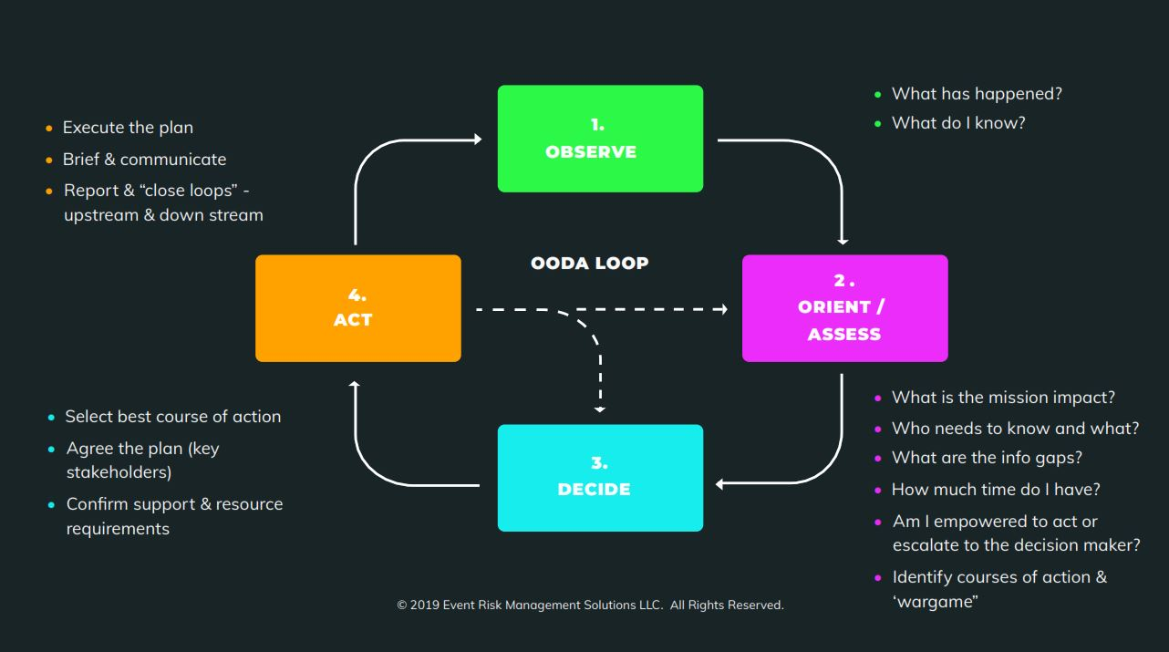
Decision Making under Uncertainty: The OODA Loop
Adopted from Boyd’s OODA loop (Boyd, 1979), Figure 2 provides a simplified but structured checklist approach to support decision-making under uncertainty by event organizers and their operational management team.

Slide 6
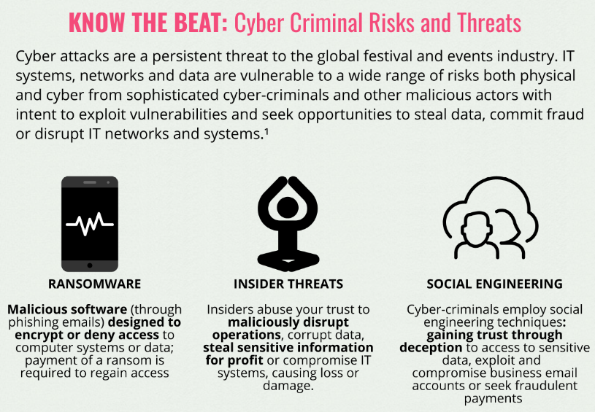
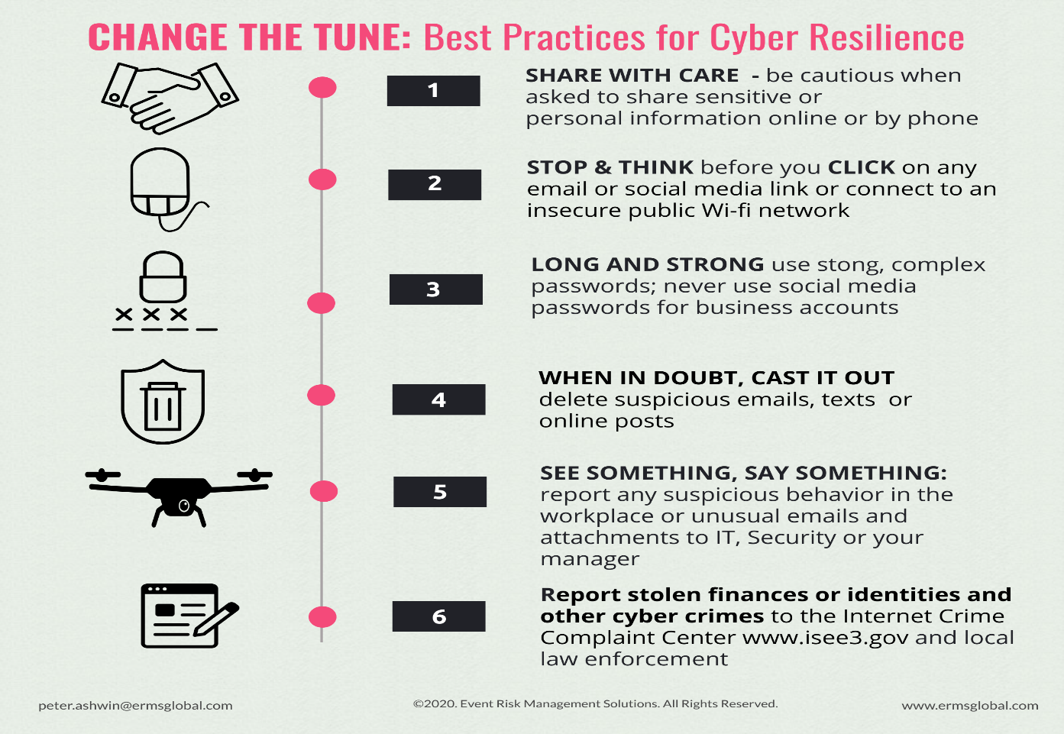
Cyber Criminal Threats to Events
Cyber Security Practices for Event Organizers

